Slide 1
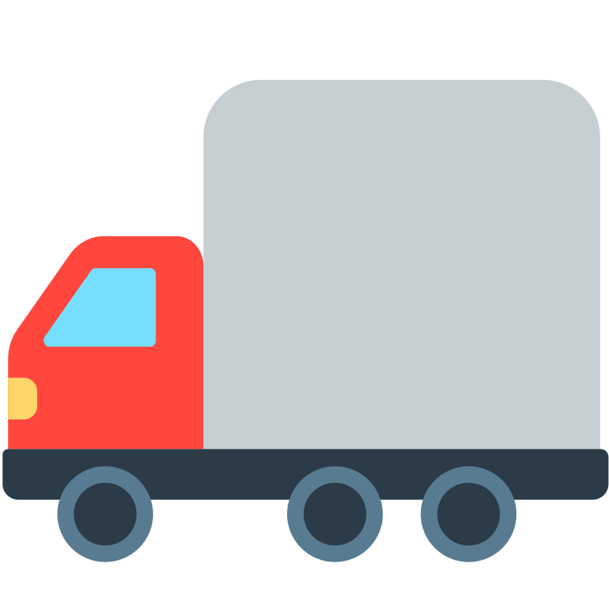
TRUCK FLEET ANALYSIS
Group 8:
Debasmita Ray
Tara Canugovi
Sahil Salvi Brandon Hu
Bhumika Punjabi
Problem Statement:
Az National Trucking (ANT), a long-haul trucking company, must manage and reduce risk associated with its fleet of drivers to comply with federal and state regulations and mitigate insurance liabilities. A key risk factor being evaluated in this phase is Mileage/Speed, with drivers who exceed a risk threshold of 7.0 or higher (on a scale of 10) flagged as high-risk.
Project Objective:
The objective of this project is to analyze geolocation and driving behavior data to identify high-risk drivers based on factors such as mileage, speed, and calculated risk scores. The findings are visualized through interactive dashboards in Power BI, providing actionable insights that enable ANT to proactively manage driver compliance, enhance road safety, and make informed, data-driven insurance decisions.

Slide 2
2
3
End-to-End Workflow :
1
Data Cleaning and Transformation in Power BI
Feature Engineering
Data Source and Preparation
— Missing values were identified and removed to ensure model consistency. — Date columns were converted from text to proper datetime format, and location fields were standardized. — Applied data type uniformity across all fields to prevent model and visual inconsistencies. — Used Power BI’s Transform Data pane to detect and remove extreme outliers based on standard deviation thresholds. — Risk factor column was normalized to a 1–10 scale for consistency in scoring and comparison.
— Created new columns to enrich the dataset: > Weekday, DayType (Weekday Weekend) > Risk Level (High/Low based on threshold) > Event Type classification
— These features enabled time-based, geographic, and behavioral insights for better segmentation.
— The raw data files were first transferred to a Cloudera virtual environment, where data ingestion and table creation were handled using HDFS-based tools. — We used Apache Pig and Hive to preprocess and define the schema, then synced the curated tables to Impala for optimized querying. — From Impala, the data tables were connected and loaded into Power BI for further analysis and visualization.
This end-to-end workflow combines data engineering, visualization, and machine learning to deliver actionable driver safety insights and proactive risk mitigation strategies.
4
6
Predictive Modeling in KNIME
Visualization Development
5
Using Power BI, we built five targeted dashboards for our five business questions:
— Driver Overview: Risk classification, KPIs, scatter plots.
— Truck Performance: Fuel efficiency, usage, and high-risk trucks.
— Geographic Risk Landscape: Map views, city-level patterns.
— Temporal Patterns & Risk Trends: Time-of-day and weekday/weekend comparisons.
— Event & Safety Insight: Event breakdown by type, location, and driver.
We also integrated R visualizations within Power BI for custom stylized charts, such as maroon-themed event bars and scatter plots.
After extracting insights from Power BI, we transitioned to predictive analytics using KNIME to anticipate future risks before they escalate.
We exported cleaned and engineered data into KNIME to build a machine learning model designed to predict future high-risk drivers, even if their current risk factor is low. The model was trained using features such as:
Average Speed
Miles Driven
Event Type Frequency
City-wise Patterns
Risk Factor Trends Over Time
Truck Model & Usage
We applied logistic regression and the model provides a binary risk flag (High/Low) for each driver and is capable of identifying early signs of behavioral risk by analyzing subtle patterns that human judgment may overlook.
Insight Extraction & Decision Support
With the dashboards in place, we:
— Identified high-risk drivers and vehicles by location and behavior.
— Highlighted fuel inefficiencies and cost drivers.
— Uncovered time-based trends, helping define better scheduling strategies.
Proposed next steps: targeted training, maintenance schedules, safety policy updates.

Slide 3
Business Questions:
Driver Overview
Truck Performance
Geographic Risk Landscape
Temporal Patterns and Risk Trends
Event and Safety Insight
How can we identify and mitigate safety risks by analyzing driver behavior, mileage patterns, and risk factors to enhance fleet compliance and reduce liability?
Which trucks are driving up operational risk and costs through poor fuel efficiency and high-risk scores, and how can we optimize performance to reduce waste and improve safety?
Where, when, and by whom are risky driving behaviors occurring, and how can we use this insight to improve safety across our fleet?
How do temporal patterns—such as time of day, day of week, and monthly trends—impact driver risk behavior and operational workload, and what actionable trends can guide scheduling, safety policies, and resource planning?
What are the most common non-normal driving events, who are the frequent violators, and how can we reduce recurring safety violations?
Write a brief bio of this facilitator. Mention the expertise they bring to this workshop.

Slide 4
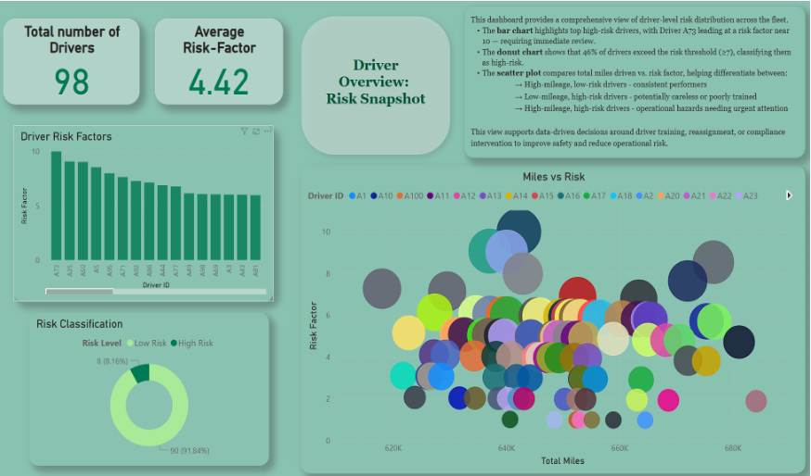
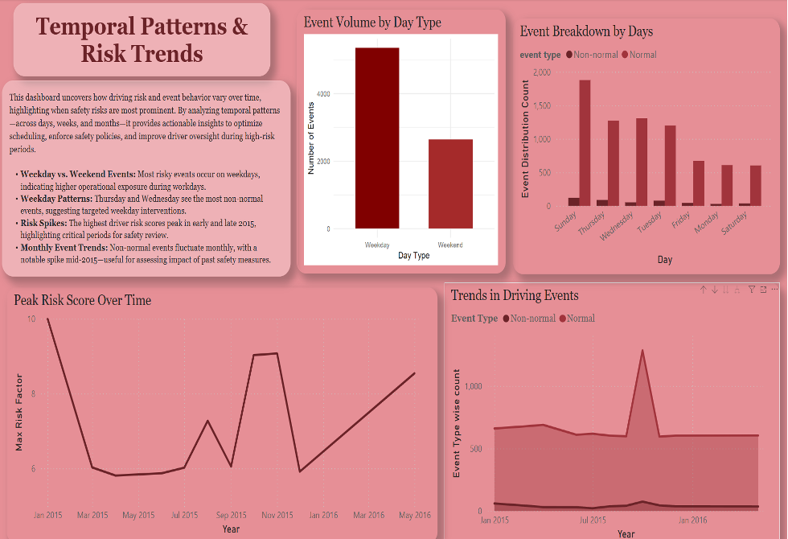
Driver Overview: Risk Snapshot
Driver Risk Factors (Bar Chart): Reveals high-risk drivers like A73 nearing the critical threshold of 10.
Risk Classification (Donut Chart): 46% of drivers exceed the high-risk threshold (>=7), requiring focused intervention.
Miles vs Risk Factor (Scatter Plot): Identifies driver clusters — high mileage + low risk (ideal performers) and high mileage + high risk
Overview Cards
Temporal Patterns and Risk trends
Event Volume by Day Type (Bar): Weekdays have higher event counts than weekends; used R in PowerBI for this visualization.
Event Breakdown by Weekday (Stacked Bar): Thursday and Wednesday have elevated non-normal events.
Peak Risk Score Over Time (Line): Spikes in mid-2015 and early 2016.
Trends in Driving Events (Area Chart): Monthly fluctuation in non-normal vs normal events.

Slide 5
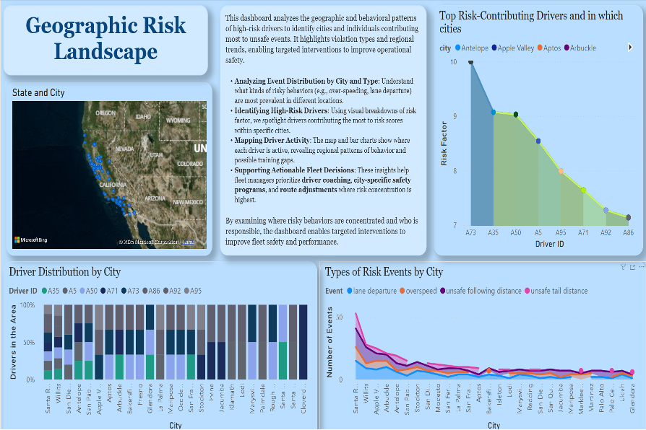
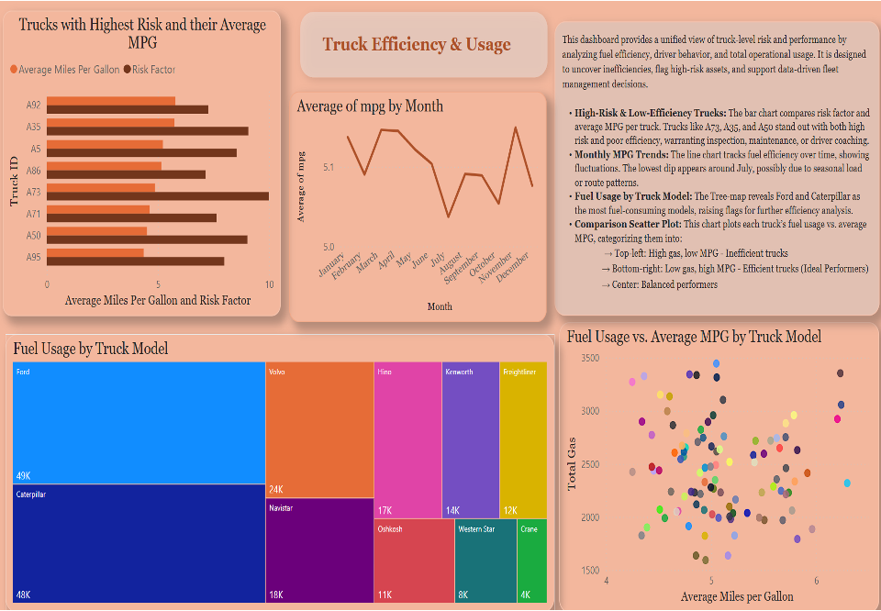
Geographic Risk Landscape
Map View (Geo Chart): Risk events are concentrated in key areas across California.
Top Risk-Contributing Drivers by City (Line+Area Chart): Highlights high-risk drivers within specific locations.
Driver Distribution (Stacked Bar): Reveals which cities have high concentrations of certain drivers.
Risk Event Type by City (Line Chart): Visualizes variation in events like lane departure or overspeed by location.
Truck Performance: Efficiency & Usage
Top Risk Trucks (Bar Chart): Trucks like A73, A35, A5 combine low MPG with high risk.
Monthly MPG Trend (Line Chart): MPG dips around July, indicating possible seasonal inefficiency.
Fuel Usage by Truck Model (Treemap): Ford and Caterpillar top fuel consumption.
Fuel Usage vs MPG (Scatter Plot): Separates high-consumption low-efficiency trucks from efficient low-risk models.

Slide 6
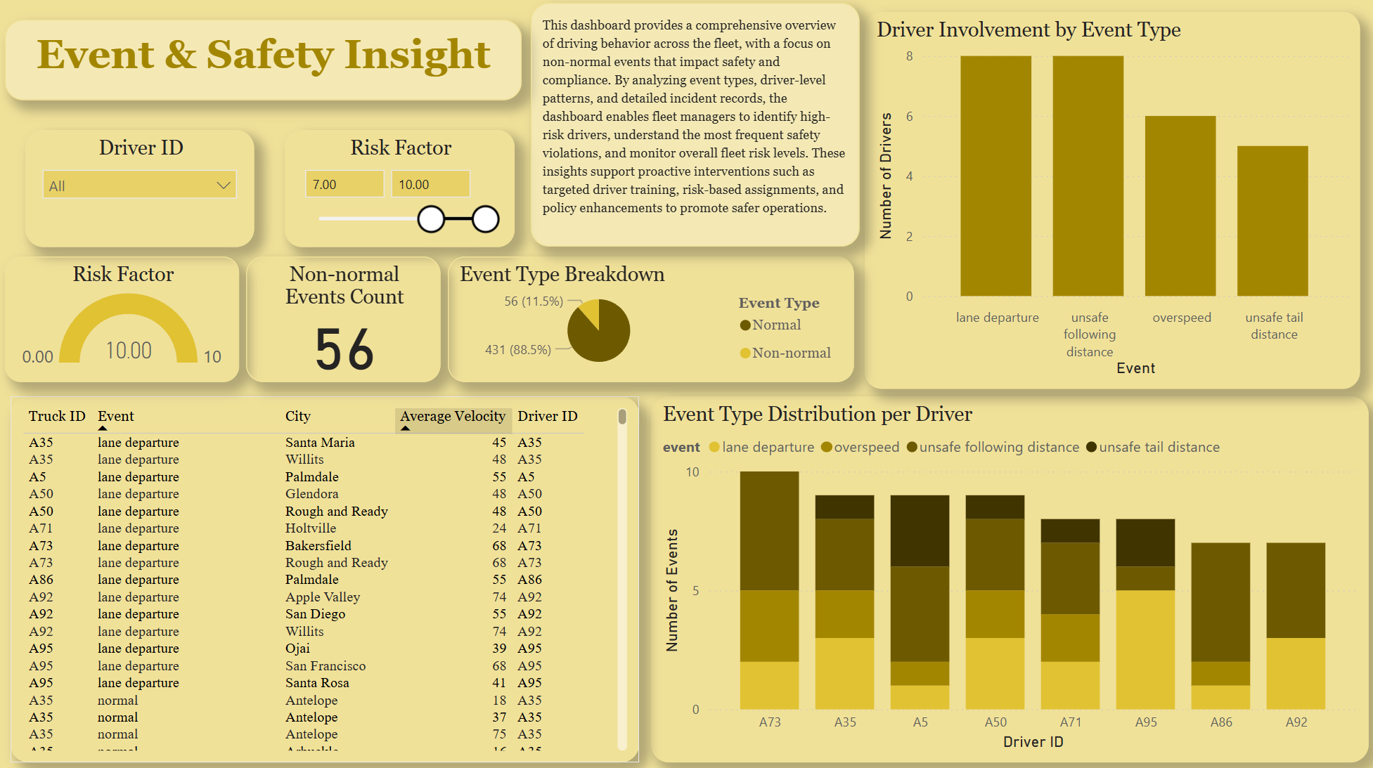
Event & Safety Insight
Event Type Breakdown (Pie Chart): 11.5% of all events are non-normal.
Driver Involvement by Event (Bar Chart): Unsafe following distance and lane departure top violations.
Event Distribution by Driver (Stacked Bar): A73, A35, A50 show repeated violations across types.
Event Log Table: Details specific risky behaviors with speed and location.
Risk Factor (Gauge): Maximum fleet risk factor.

Slide 7
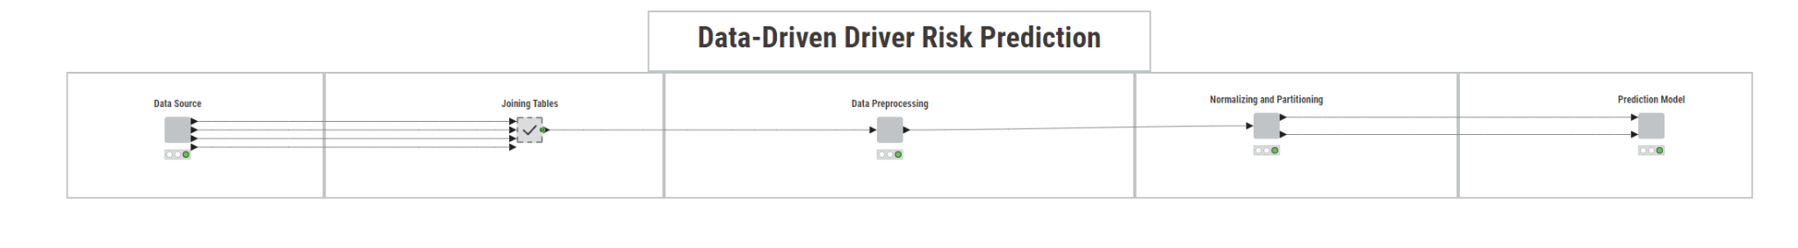
KNIME Predictive Modeling Dashboard
Objective: Leverage KNIME to build a predictive model that identifies high-risk drivers using behavioral and operational data
Workflow Overview
Data Source (1)
- Raw data sourced from Cloudera, processed via Hive and Pig, then loaded into Impala.
- Imported into KNIME for end-to-end modeling.
Data Cleaning (2)
- Joined using keys (e.g., driver ID, truck ID).
- Cleaned missing values, standardized formats, and corrected event/location labels.
Preprocessing (3)
- Feature engineering (one-hot encoding, event counts, derived risk metrics).
- Applied transformation logic for classification (like, risk bands).
Normalization & Partitioning (4)
- Normalized risk scores (1–10 range).
- Split into training/testing sets (70/30).
Predictive Modeling (5)
- Logistic Regression & Random Forest (in parallel).
- Inputs: Speed, mileage, city, truck patterns, event types.
- Output: Binary Risk Flag (High/Low) + Feature Importance.
Outcome: Model predicts high-risk behavior before it escalates—flagging subtle risk indicators beyond human judgment.

Slide 8
Our Findings:
1. Driver Overview: Risk Snapshot
Driver A73 logged significantly high risk behavior, topping the fleet with a risk factor near 10, despite being one of the more active drivers in terms of mileage. This indicates an urgent need for targeted intervention such as coaching or reassignment.
2. Truck Performance: Efficiency & Usage
Truck ID A35 (Freightliner model) recorded one of the lowest average MPG rates across the fleet in July 2015, while simultaneously exhibiting a risk factor above 7 — classifying it as both inefficient and high-risk.
3. Geographic Risk Landscape
The city of Santa Rosa showed a disproportionately high number of unsafe tail distance violations, with most of the risky drivers contributing to these incidents.
4. Temporal Patterns & Risk Trends
A notable spike in non-normal events occurred in October 2015, with peak risk scores observed on Thursdays and Fridays. Weekday activity consistently outpaces weekends in both volume and severity.
5. Event & Safety Insight
Unsafe following distance and lane departure are the top two most frequent non-normal events, each involving over 7 drivers repeatedly. A35 and A50 show recurring involvement in both categories.
Recommendations:
1. Targeted Driver Coaching
Immediately enroll high‑risk drivers (A73, A35, A50) in a focused safety‑training program and monitor monthly.
2. Risk‑Based Routing & Scheduling
Reassign or stagger routes to reduce Apple Valley and Thursday‑Friday exposure where violations spike.
3. Maintenance & Fuel‑Efficiency Audits
Inspect under‑performing trucks (A35, A73, A5) for mechanical issues; integrate MPG targets into routine service.
4. City‑Specific Safety Initiatives
Launch geo‑focused interventions (e.g., Santa Rosa safety campaign) and track local KPIs.
5. Policy & Compliance Updates
Strengthen lane‑discipline and following‑distance policies; use dash‑cam footage and KNIME risk flags for proactive enforcement.
6. Continuous Analytics Loop
Refresh dashboards weekly and retrain the KNIME model quarterly to capture emerging risk patterns.
Outcome: A data‑driven framework that cuts operational risk, trims fuel waste, and elevates fleet safety culture.

